Slide 1

Introduction to Ethical Hacking
By : Abhay Basani

Slide 2
Content
Introduction
Ethical Hacking
Who are Hackers
Types of Hackers
What should do after hack
Hacking Process
Required Skills of an EH
Conclusion

Slide 3

Introduction
Ethical hacking also known as penetration testing or white-hat hacking, involves the same tools, tricks, and techniques that hackers use, but with one major difference that Ethical Hacking is legal.
Independent Computer security Professionals breaking into the computer system.
Neither damage the target system nor steal information.
Evaluate target systems security and report back to owners about the bug found.

Slide 4
Who are Hackers?
A person who enjoy learning details of a programming language or system.
A person who enjoy actually doing the programming rather than just theorizing about it.
A person capable of appreciating someone else’s hacking.
A person who picks up programming quickly.
A person who is an expert at a particular programming language or system.

Slide 5
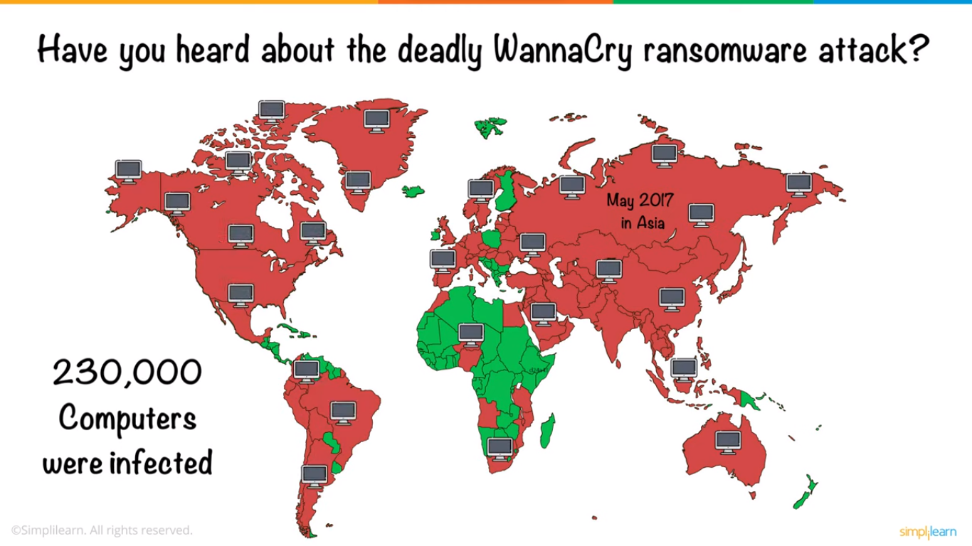

Slide 6
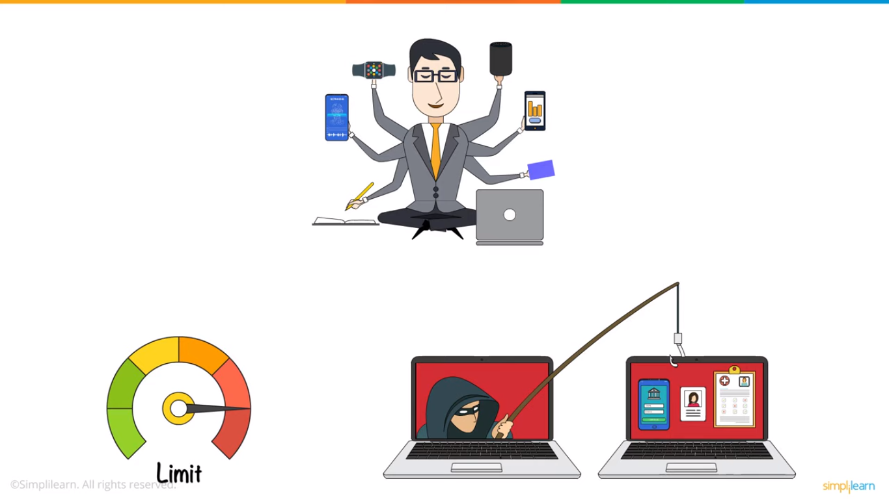

Slide 7
Types of Hacker
Black hat hacker
White hat hacker
Grey hat hacker

Slide 8
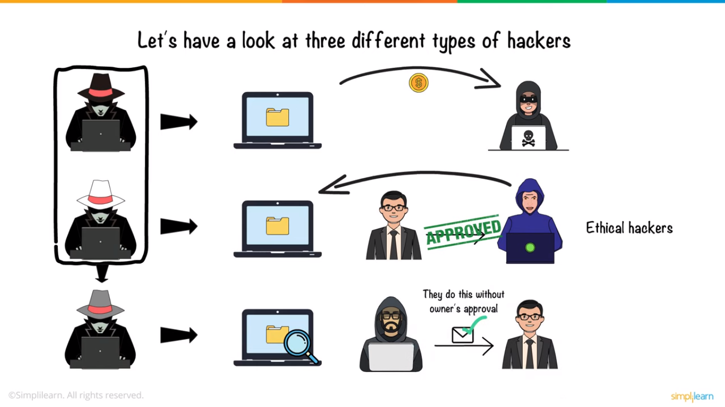

Slide 9
What should do after hacked?
Shutdown or turn off the system
Separate the system from network
Restore the system with the backup or reinstall all programs
Connect the system to the network
It can be good to call the police on your cyber security team

Slide 10
Hacking Process
Planning and Reconnaissance
Scanning
Gaining Access
Maintaining Access
Analysis and Reporting
Remediation (Share the findings and recommendations)
Documentation

Slide 11
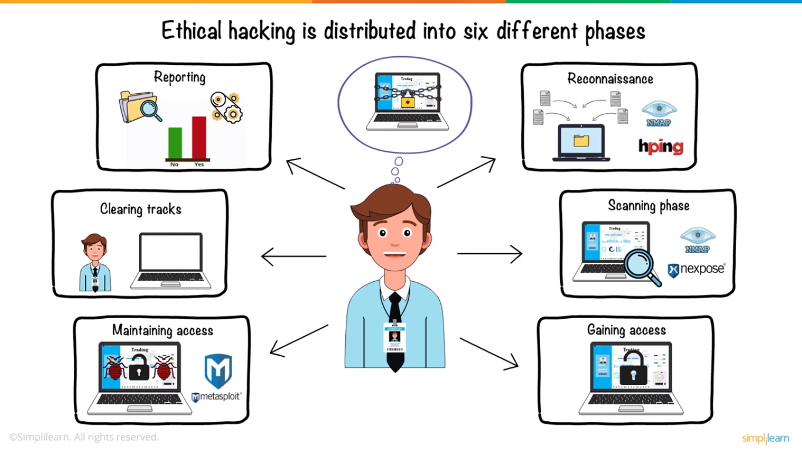

Slide 12
Required Skills of an Ethical Hacker?
Computer Networking
Operating Systems
Programming And Scripting
Cyber Sec fundamentals
Cryptography
Linux
Firewalls
Networking

Slide 13
Conclusion
Ethical hacking plays a pivotal role in safeguarding digital environments from malicious threats. By harnessing the skills of cybersecurity experts who emulate the tactics of potential attackers, organizations can identify vulnerabilities, rectify weaknesses, and fortify their defenses.
Ethical hackers operate within a framework of responsible conduct and legal compliance, leveraging their technical prowess to uncover security flaws before malicious actors can exploit them.

